Slide 1
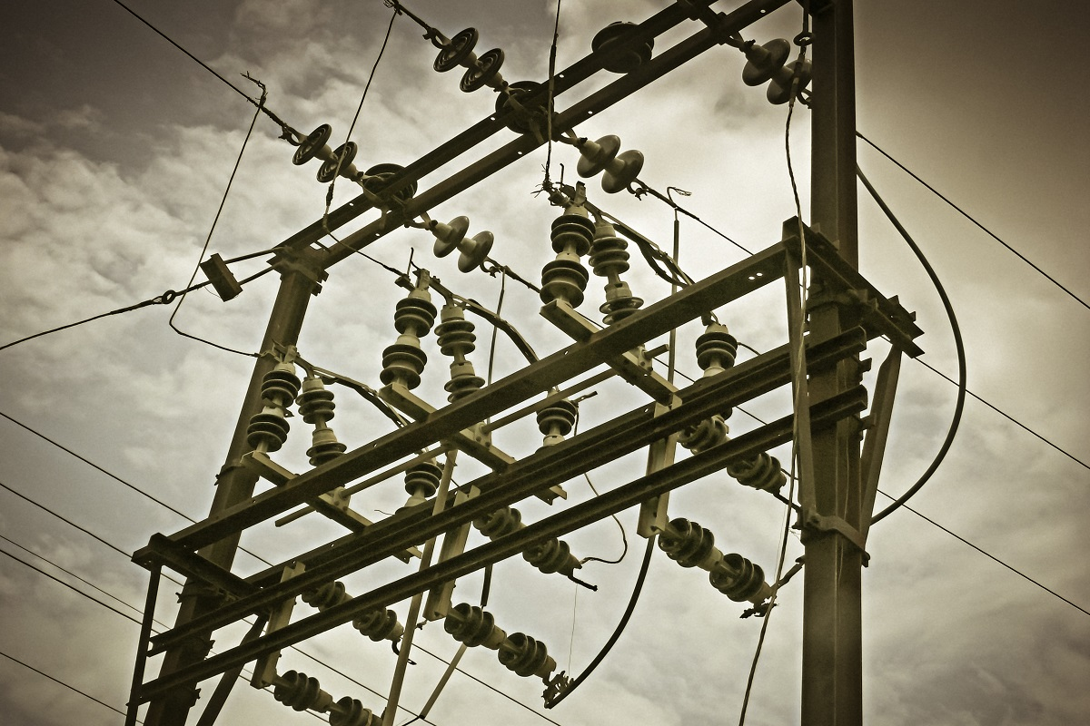
WORLD ELECTRICITY ANALYSIS
A descriptive analysis of access to electricity, production from different sources(nuclear, oil & renewable energy) and distribution losses across different countries.

Slide 2
Access to electricity
Country access post-2000s.
Country access: World Average Access.
A trend of increasing countries with electricity access to rural.
Electricity Production.
Evolution of production through nuclear power by region and Income Group.
Evolution of production across different sources.
Distribution losses
Comparison between distribution losses and access.
Comparison between distribution losses and production.

Slide 3
Country access from 2000
Average electricity access by different countries

Slide 4
Average Electricity Access Comparison.
A comparison overview of Yearly electricity Access.

Slide 5
Region-wise Nuclear energy Production (sum)
Europe & Central Asia has the highest nuclear energy production whereas the Middle East & North Africa has the lowest.

Slide 6
Electricity Production Sources
The highest electricity has produced from a renewable source
And lowest from nuclear source

Slide 7
production across different sources
Production through oil sources has been in declining trend in recent years, which can be attributed to environmental concerns and awareness.
Increasing trend in production through nuclear energy can be attributed to increased efficiency.
Production through renewable sources has seen a sharp increasing trend from mid-1970s, can be attributed to environmental concerns and awareness.

Slide 8
RELATION between distribution losses and Production.
Diversifying production from different sources as alternatives can minimize distribution losses.
Assumptions: considered statistics till 2008.

Slide 9

A COLLABORARTIVE PROJECT BY
Suman Kumar
Divik Maheshwari

